Slide 1

Where is a mobile map used in map-assisted pedestrian navigation?
Author: Zhengfang Xu
Supervisor: Prof. Dr. Sara Irina Fabrikant
Dr. Mona Bartling

Slide 2
Intro
RQ
Data
Method
Timeline
When using a mobile map to navigate to a new place, where do you need to unlock the phone screen and check the map?

Slide 3

Intro
RQ
Data
Method
Timeline
To understand where people check the map, we need to know why people check the map.
Related research: motivations behind checking map
Wayfinding behavioral actions are those linked to
orientation,
route decision,
route monitoring,
destination recognition
(Carpman & Grant, 2002)

Slide 4

Intro
RQ
Data
Method
Timeline
Checking map assists people in making decision during navigation.
Related research: decision making during navigation
Pedestrians tend to make decisions before reaching intersections.
People with higher spatial ability, earlier to make decisions.
(Brunyé et al., 2018)

Slide 5




Intro
RQ
Data
Method
Timeline
Map use strategies help us understand where people check map.
Related research: types of map use strategies during navigation
constant
support
independent and attentive
least effort and inattentive
(Webber et al., 2012)

Slide 6
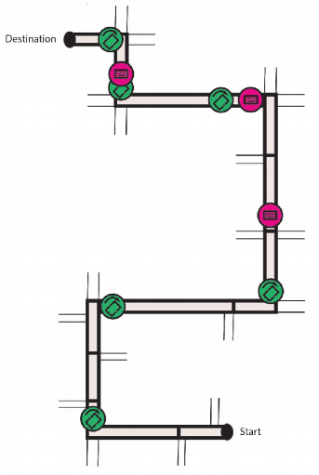
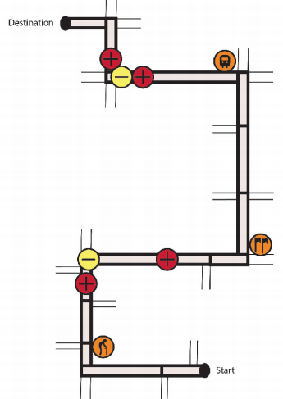
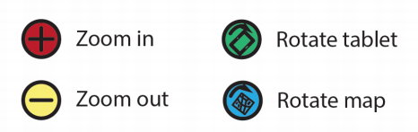
Intro
RQ
Data
Method
Timeline
Map use strategies help us understand where people check map.
Related research: types of map use strategies during navigation
Taking specific map interaction types into consideration.
(Brügger, 2020)

Slide 7
Intro
RQ
Data
Method
Timeline
Research Gap:
The existing research on map checking primarily focuses on intersections, with fewer studies investigating other trajectory factors (e.g., road length, turns, landmarks, shortcuts etc.).
Most studies use predetermined route for research and seldom consider the impact of route variations.
Example: The map checking behavior around intersections differs between first one and last one.
Little research explored how environmental changes such as traffic density affect people's map-checking behavior.

Slide 8
Intro
RQ
Data
Method
Timeline
Research Question:
1. What are factors (e.g., intersections, turns, length etc.) that influence pedestrian map checking behavior, and how these factors affect it?
2. What are the differences in map-checking behavior between heavy and light traffic density environments?

Slide 9
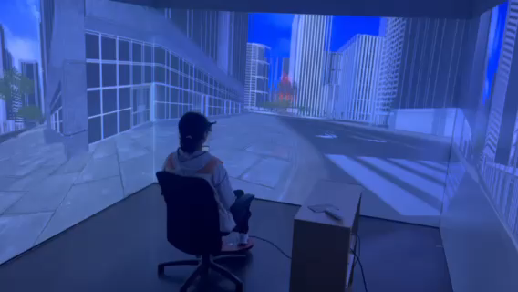
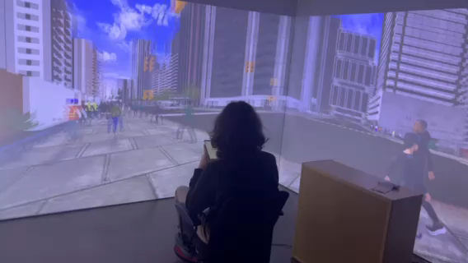
Intro
RQ
Data
Method
Timeline
Data Resource: VR Experiment
Study on mobile map assisted wayfinding
Total study participants: 54
Environmental conditions:
Light and heavy traffic density
Number of recorded wayfinding task trajectories: 863

Slide 10
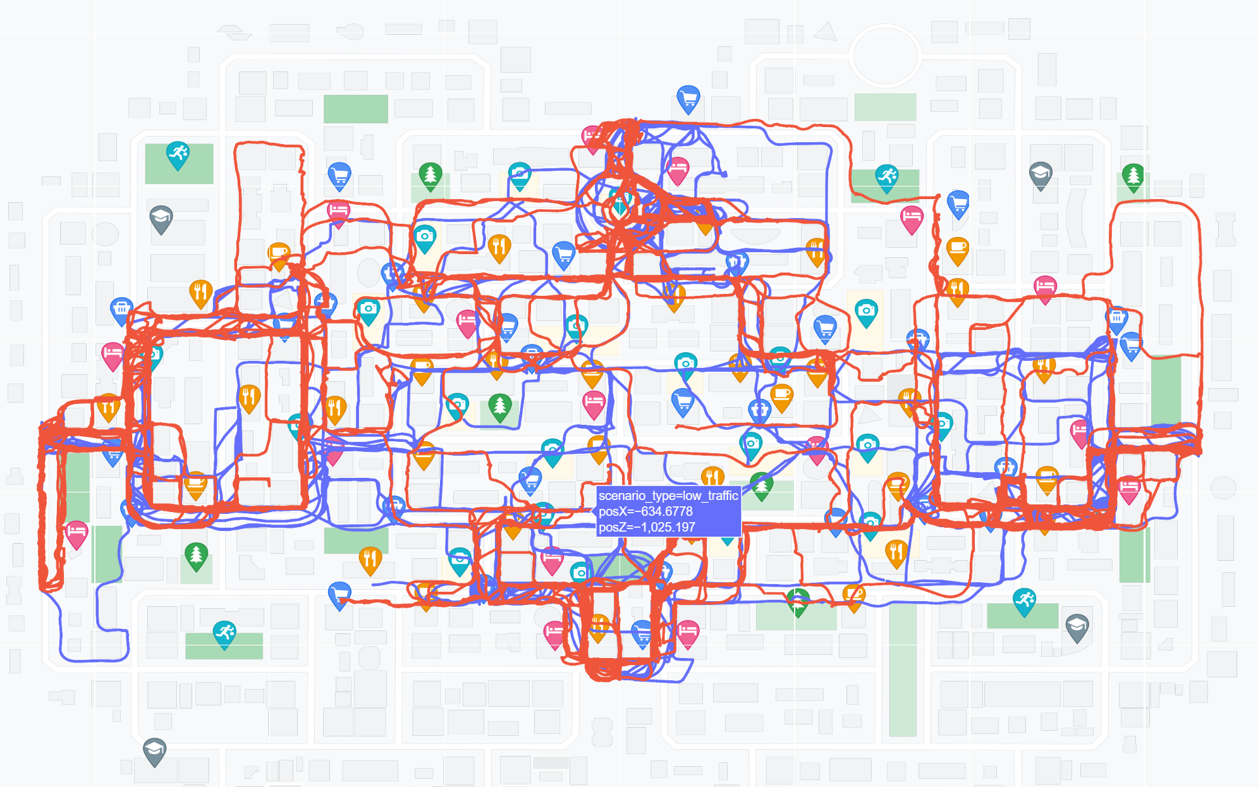
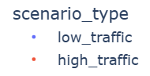
Intro
RQ
Data
Method
Timeline
Data Display:
Light traffic
Heavy traffic

Slide 11
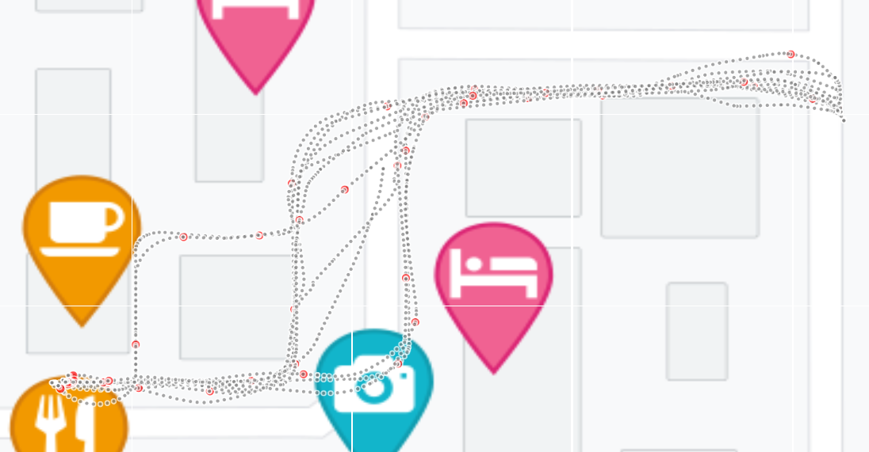
Intro
RQ
Data
Method
Timeline
Data Display:

Slide 12

Intro
RQ
Data
Method
Timeline
Method:
From the perspective of the number of map checking:
Exploratory data analysis on potential factors
Length, number of turns, number of intersections, shortcut involvement, numbers of landmarks, etc.
Regression analysis on potential factors against the number of map checking
Build model to predict the number of map checking
Comparative analysis
Comparing the differences between heavy traffic density and light traffic density.

Slide 13
Intro
RQ
Data
Method
Timeline
Method:
From the perspective of spatial distribution:
Abstracting trajectory

Slide 14
Intro
RQ
Data
Method
Timeline
Method:
From the perspective of spatial distribution:
Cluster the abstracted routes based on the distribution of key features.
Visualize map checking points on the standardized routes
Comparative analysis
Compare and analyze the distribution of map checking across different types of trajectories and traffic density.

Slide 15
Intro
RQ
Data
Method
Timeline
1 Feb. 2024
Start of master thesis
16 Apr. 2024
Concept talk
15 May 2024
Exploratory analysis
15 June 2024
Analysis in terms of the number of map checking
15 July 2024
Analysis in terms of spatial distribution of map checking
31 Aug. 2024
Thesis writing
30 Sep. 2024
Submission of the Master’s Thesis
1 Nov. 2024
Master’s Exam

Slide 16
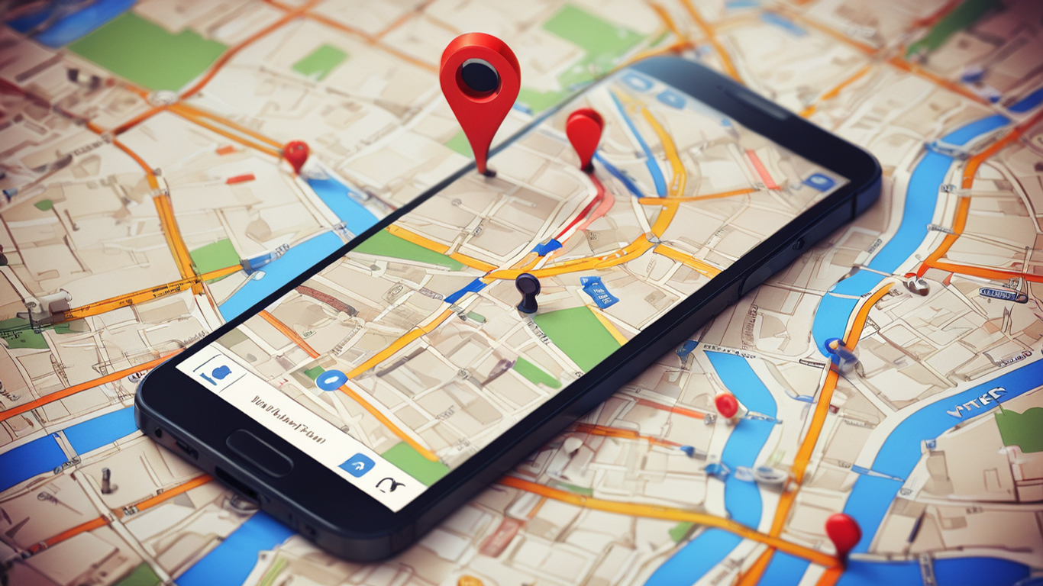
Thank you very much!

